Slide 1
Data Wrangling: Munging, Tidy Data, and Working with Multiple Data Tables (III)
Nicholas Mattei, Tulane University
CMPS3660 – Introduction to Data Science – Fall 2019
https://rebrand.ly/TUDataScience
Many Thanks
Slides based off Introduction to Data Science from John P. Dickerson - https://cmsc320.github.io/

Slide 2
Announcements
Project1 LXML Fix.
Early Office Hours Today
Help, email Ari and Myself.
Correcting My Mistakes:
Groups Access
Merge, Join Terms Slide
Weekly Questions 5
Test Advice
Lecture then Lab Time!

Slide 3
The Data LifeCycle
Data Collection
Data Processing
Exploratory Analysis
&
Data Visualization
Analysis, Hypothesis Testing,
& ML
Insight
&
Policy Decision
Today

Slide 4
SQL And Relational Data
Relational data:
What is a relation, and how do they interact?
Querying databases:
SQL
SQLite
How does this relate to pandas?
Joins in SQL
Thanks to Zico Kolter for some structure for this lecture!

Slide 5
Relation
Simplest relation: a table aka tabular data full of unique tuples
Variables
(called attributes)
Labels
ID | age | wgt_kg | hgt_cm
1 | 12.2 | 42.3 | 145.1
2 | 11.0 | 40.8 | 143.8
3 | 15.6 | 65.3 | 165.3
4 | 35.1 | 84.2 | 185.8
Observations
(called tuples)

Slide 6
Primary keys
ID | age | wgt_kg | hgt_cm | nat_id
1 | 12.2 | 42.3 | 145.1 | 1
2 | 11.0 | 40.8 | 143.8 | 1
3 | 15.6 | 65.3 | 165.3 | 2
4 | 35.1 | 84.2 | 185.8 | 1
5 | 18.1 | 62.2 | 176.2 | 3
6 | 19.6 | 82.1 | 180.1 | 1
ID | Nationality
1 | USA
2 | Canada
3 | Mexico
The primary key is a unique identifier for every tuple in a relation.
Each tuple has exactly one primary key

Slide 7
Wait, Aren’t These Called “indexes”?
Yes, in Pandas; but not in the database world
For most databases, an “index” is a data structure used to speed up retrieval of specific tuples
For example, to find all tuples with nat_id = 2:
We can either scan the table – O(N)
Or use an “index” (e.g., binary tree) – O(log N)

Slide 8
Foreign keys
ID | age | wgt_kg | hgt_cm | nat_id
1 | 12.2 | 42.3 | 145.1 | 1
2 | 11.0 | 40.8 | 143.8 | 1
3 | 15.6 | 65.3 | 165.3 | 2
4 | 35.1 | 84.2 | 185.8 | 1
5 | 18.1 | 62.2 | 176.2 | 3
6 | 19.6 | 82.1 | 180.1 | 1
ID | Nationality
1 | USA
2 | Canada
3 | Mexico
Foreign keys are attributes (columns) that point to a different table’s primary key.
A table can have multiple foreign keys

Slide 9
Relation Schema
A list of all the attribute names, and their domains
create table department
(dept_name varchar(20),
building varchar(15),
budget numeric(12,2) check (budget > 0),
primary key (dept_name)
);
SQL Statements
To create Tables
create table instructor (
ID char(5), name varchar(20) not null, dept_name varchar(20), salary numeric(8,2),
primary key (ID), foreign key (dept_name) references department
)

Slide 10
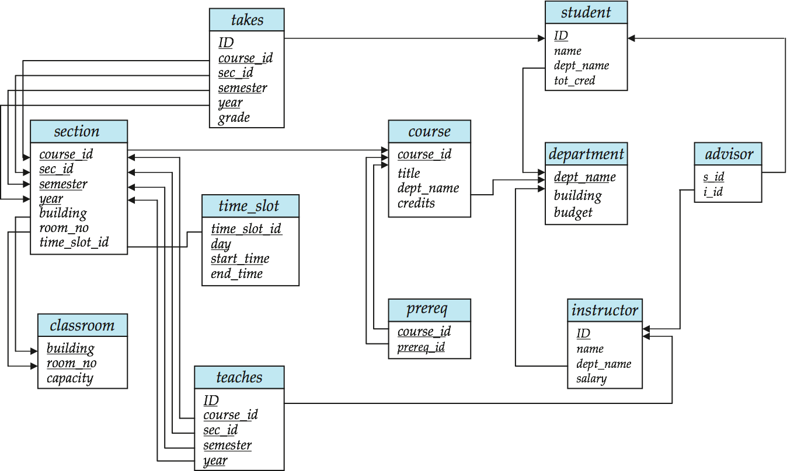
Schema Diagrams

Slide 11
Searching for elements
Find all people with nationality Canada (nat_id = 2):
???????????????
ID | age | wgt_kg | hgt_cm | nat_id
1 | 12.2 | 42.3 | 145.1 | 1
2 | 11.0 | 40.8 | 143.8 | 1
3 | 15.6 | 65.3 | 165.3 | 2
4 | 35.1 | 84.2 | 185.8 | 1
5 | 18.1 | 62.2 | 176.2 | 3
6 | 19.6 | 82.1 | 180.1 | 1
O(n)

Slide 12
Indexes
Like a hidden sorted map of references to a specific attribute (column) in a table.
Allows O(log n) lookup instead of O(n)
loc | ID | age | wgt_kg | hgt_cm | nat_id
0 | 1 | 12.2 | 42.3 | 145.1 | 1
128 | 2 | 11.0 | 40.8 | 143.8 | 2
256 | 3 | 15.6 | 65.3 | 165.3 | 2
384 | 4 | 35.1 | 84.2 | 185.8 | 1
512 | 5 | 18.1 | 62.2 | 176.2 | 3
640 | 6 | 19.6 | 82.1 | 180.1 | 1
nat_id | locs
1 | 0, 384, 640
2 | 128, 256
3 | 512

Slide 13
INdexes
Actually implemented with data structures like B-trees
In a full Databases course you would learn how to store and make these!
But: indexes are not free
Takes memory to store
Takes time to build
Takes time to update (add/delete a row, update the column)
But, but: one index is (mostly) free
Index will be built automatically on the primary key
Think before you build/maintain an index on other attributes!

Slide 14
Relationships
Primary keys and foreign keys define interactions between different tables aka entities. Four types:
One-to-one
One-to-one-or-none
One-to-many and many-to-one
Many-to-many
Connects (one, many) of the rows in one table to (one, many) of the rows in another table

Slide 15
One-to-many & Many-to-one
One person can have one nationality (in this example), but one nationality can include many people.
Person
Nationality
ID | age | wgt_kg | hgt_cm | nat_id
1 | 12.2 | 42.3 | 145.1 | 1
2 | 11.0 | 40.8 | 143.8 | 1
3 | 15.6 | 65.3 | 165.3 | 2
4 | 35.1 | 84.2 | 185.8 | 1
5 | 18.1 | 62.2 | 176.2 | 3
6 | 19.6 | 82.1 | 180.1 | 1
ID | Nationality
1 | USA
2 | Canada
3 | Mexico

Slide 16
One-to-One
Two tables have a one-to-one relationship if every tuple in the first tables corresponds to exactly one entry in the other
In general, you won’t be using these (why not just merge the rows into one table?) unless:
Split a big row between SSD and HDD or distributed
Restrict access to part of a row (some DBMSs allow column-level access control, but not all)
Caching, partitioning, & other serious stuff that we won’t cover.
Person
SSN

Slide 17
One-to-One-Or-None
Say we want to keep track of people’s cats:
People with IDs 2 and 3 do not own cats*, and are not in the table. Each person has at most one entry in the table.
Is this data tidy?
Person ID | Cat1 | Cat2
1 | Chairman Meow | Fuzz Aldrin
4 | Anderson Pooper | Meowly Cyrus
5 | Gigabyte | Megabyte
Person
Cat
*nor do they have hearts, apparently.

Slide 18
Many-to-Many
Say we want to keep track of people’s cats’ colorings:
One column per color, too many columns, too many nulls
Each cat can have many colors, and each color many cats
ID | Name
1 | Megabyte
2 | Meowly Cyrus
3 | Fuzz Aldrin
4 | Chairman Meow
5 | Anderson Pooper
6 | Gigabyte
Cat ID | Color ID | Amount
1 | 1 | 50
1 | 2 | 50
2 | 2 | 20
2 | 4 | 40
2 | 5 | 40
3 | 1 | 100
Cat
Color

Slide 19
Associative tables
Cats
Colors
Cat ID | Color ID | Amount
1 | 1 | 50
1 | 2 | 50
2 | 2 | 20
2 | 4 | 40
2 | 5 | 40
3 | 1 | 100
ID | Name
1 | Megabyte
2 | Meowly Cyrus
3 | Fuzz Aldrin
4 | Chairman Meow
5 | Anderson Pooper
6 | Gigabyte
ID | Name
1 | Black
2 | Brown
3 | White
4 | Orange
5 | Neon Green
6 | Invisible
Typically used to model pure relationships, not entities.
The Primary Keys are from other tables – here we have [CatID, ColorID]
Pros:
Handles one-to-one, one-to-many, and many-to-one
Can be added without modifying existing tables.
Cons:
Requries extra joins/queries to learn certain things.

Slide 20
Aside: Pandas
So, this kinda feels like pandas …
And pandas kinda feels like a relational data system …
Pandas is not strictly a relational data system:
No notion of primary / foreign keys
It does have indexes (and multi-column indexes):
pandas.Index: ordered, sliceable set storing axis labels
pandas.MultiIndex: hierarchical index
Rule of thumb: do heavy, rough lifting at the relational DB level, then fine-grained slicing and dicing and visualization with pandas

Slide 21
SQLite
On-disk relational database management system (RDMS)
Applications connect directly to a file.
Most RDMSs have applications connect to a server:
Advantages include greater concurrency, less restrictive locking
Disadvantages include, for this class, setup time ☺
Installation:
conda install -c anaconda sqlite
(Should come preinstalled, I think?)
All interactions use Structured Query Language (SQL)

Slide 22
Using a DB with Pandas!
Persists!
Raw Input
Python
SQLite File
SQL
SQL
Structured output (trained classifiers, JSON for D3, visualizations)
SQLite CLI & GUI Frontend
Persists!

Slide 23
Crash Course in SQL (in python)
import sqlite3
# Create a database and connect to it
conn = sqlite3.connect(“cmsc320.db”)
cursor = conn.cursor()
# do cool stuff
conn.close()
Cursor: temporary work area in system memory for manipulating SQL statements and return values
If you do not close the connection (conn.close()), any outstanding transaction is rolled back
(More on this in a bit.)

Slide 24
Crash Course in SQL (in python)
# Make a table
cursor.execute(“””
CREATE TABLE cats (
id INTEGER PRIMARY KEY,
name TEXT
)”””)
?????????
id | name
cats
Capitalization doesn’t matter for SQL reserved words
SELECT = select = SeLeCt
Rule of thumb: capitalize keywords for readability

Slide 25
Crash Course in SQL (in python)
# Insert into the table
cursor.execute(“INSERT INTO cats VALUES (1, ’Megabyte’)”)
cursor.execute(“INSERT INTO cats VALUES (2, ‘Meowly Cyrus’)”)
cursor.execute(“INSERT INTO cats VALUES (3, ‘Fuzz Aldrin’)”)
conn.commit()
id | name
1 | Megabyte
2 | Meowly Cyrus
3 | Fuzz Aldrin
# Delete row(s) from the table
cursor.execute(“DELETE FROM cats WHERE id == 2”);
conn.commit()
id | name
1 | Megabyte
3 | Fuzz Aldrin

Slide 26
Crash Course in SQL (in python)
# Read all rows from a table
for row in cursor.execute(”SELECT * FROM cats”):
print(row)
# Read all rows into pandas DataFrame
pd.read_sql_query(“SELECT * FROM cats”, conn, index_col=”id”)
id | name
1 | Megabyte
3 | Fuzz Aldrin
index_col=“id”: treat column with label “id” as an index
index_col=1: treat column #1 (i.e., “name”) as an index
(Can also do multi-indexing.)

Slide 27
Joining data
A join operation merges two or more tables into a single relation. Different ways of doing this:
Inner
Left
Right
Full Outer
Join operations are done on columns that explicitly link the tables together

Slide 28
Inner Joins
id | name
1 | Megabyte
2 | Meowly Cyrus
3 | Fuzz Aldrin
4 | Chairman Meow
5 | Anderson Pooper
6 | Gigabyte
cat_id | last_visit
1 | 02-16-2017
2 | 02-14-2017
5 | 02-03-2017
visits
cats
Inner join returns merged rows that share the same value in the column they are being joined on (id and cat_id).
id | name | last_visit
1 | Megabyte | 02-16-2017
2 | Meowly Cyrus | 02-14-2017
5 | Anderson Pooper | 02-03-2017

Slide 29
Inner Joins
# Inner join in pandas
df_cats = pd.read_sql_query(“SELECT * from cats”, conn)
df_visits = pd.read_sql_query(“SELECT * from visits”, conn)
df_cats.merge(df_visits, how = “inner”,
left_on = “id”, right_on = ”cat_id”)
# Inner join in SQL / SQLite via Python
cursor.execute(“””
SELECT
*
FROM
cats, visits
WHERE
cats.id == visits.cat_id
”””)

Slide 30
Left Joins
Inner joins are the most common type of joins (get results that appear in both tables)
Left joins: all the results from the left table, only some matching results from the right table
Left join (cats, visits) on (id, cat_id) ???????????
id | name | last_visit
1 | Megabyte | 02-16-2017
2 | Meowly Cyrus | 02-14-2017
3 | Fuzz Aldrin | NULL
4 | Chairman Meow | NULL
5 | Anderson Pooper | 02-03-2017
6 | Gigabyte | NULL

Slide 31
Right Joins
id | name
1 | Megabyte
2 | Meowly Cyrus
3 | Fuzz Aldrin
4 | Chairman Meow
5 | Anderson Pooper
6 | Gigabyte
cat_id | last_visit
1 | 02-16-2017
2 | 02-14-2017
5 | 02-03-2017
7 | 02-19-2017
12 | 02-21-2017
Take a guess!
Right join (cats, visits) on (id, cat_id) ???????????
visits
cats
id | name | last_visit
1 | Megabyte | 02-16-2017
2 | Meowly Cyrus | 02-14-2017
5 | Anderson Pooper | 02-03-2017
7 | NULL | 02-19-2017
12 | NULL | 02-21-2017

Slide 32
Left/Right Joins
# Left join in pandas
df_cats.merge(df_visits, how = “left”,
left_on = “id”, right_on = ”cat_id”)
# Left join in SQL / SQLite via Python
cursor.execute(“SELECT * FROM cats LEFT JOIN visits ON
cats.id == visits.cat_id”)
# Right join in pandas
df_cats.merge(df_visits, how = “right”,
left_on = “id”, right_on = ”cat_id”)
# Right join in SQL / SQLite via Python
☹

Slide 33
Full Outer Join
Combines the left and the right join ???????????
id | name | last_visit
1 | Megabyte | 02-16-2017
2 | Meowly Cyrus | 02-14-2017
3 | Fuzz Aldrin | NULL
4 | Chairman Meow | NULL
5 | Anderson Pooper | 02-03-2017
6 | Gigabyte | NULL
7 | NULL | 02-19-2017
12 | NULL | 02-21-2017
# Outer join in pandas
df_cats.merge(df_visits, how = “outer”,
left_on = “id”, right_on = ”cat_id”)

Slide 34
Google Image Search One Slide SQL Join Visual
Image credit: http://www.dofactory.com/sql/join

Slide 35
Group by Aggregates
SELECT nat_id, AVG(age) as average_age
FROM persons GROUP BY nat_id
ID | age | wgt_kg | hgt_cm | nat_id
1 | 12.2 | 42.3 | 145.1 | 1
2 | 11.0 | 40.8 | 143.8 | 1
3 | 15.6 | 65.3 | 165.3 | 2
4 | 35.1 | 84.2 | 185.8 | 1
5 | 18.1 | 62.2 | 176.2 | 3
6 | 19.6 | 82.1 | 180.1 | 1
nat_id | average_age
1 | 19.48
2 | 15.6
3 | 18.1

Slide 36
Raw SQL in Pandas
If you “think in SQL” already, you’ll be fine with pandas:
conda install -c anaconda pandasql
Info: http://pandas.pydata.org/pandas-docs/stable/comparison_with_sql.html
# Write the query text
q = ”””
SELECT
*
FROM
cats
LIMIT 10;”””
# Store in a DataFrame
df = sqldf(q, locals())

